Slide 1
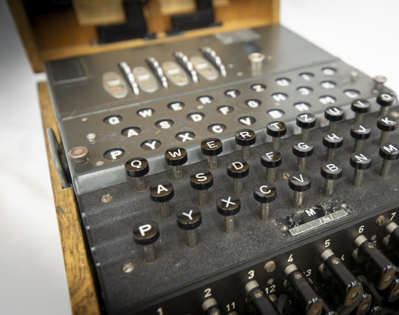
The Enigma Machine
Asaf Ben-Shabat
Or Eliyahu
Sami Odeh
Tal Vakrat

Slide 2
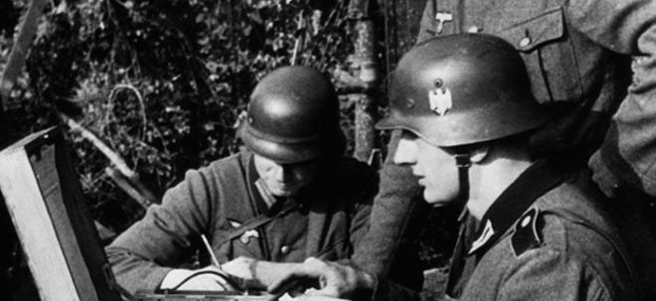
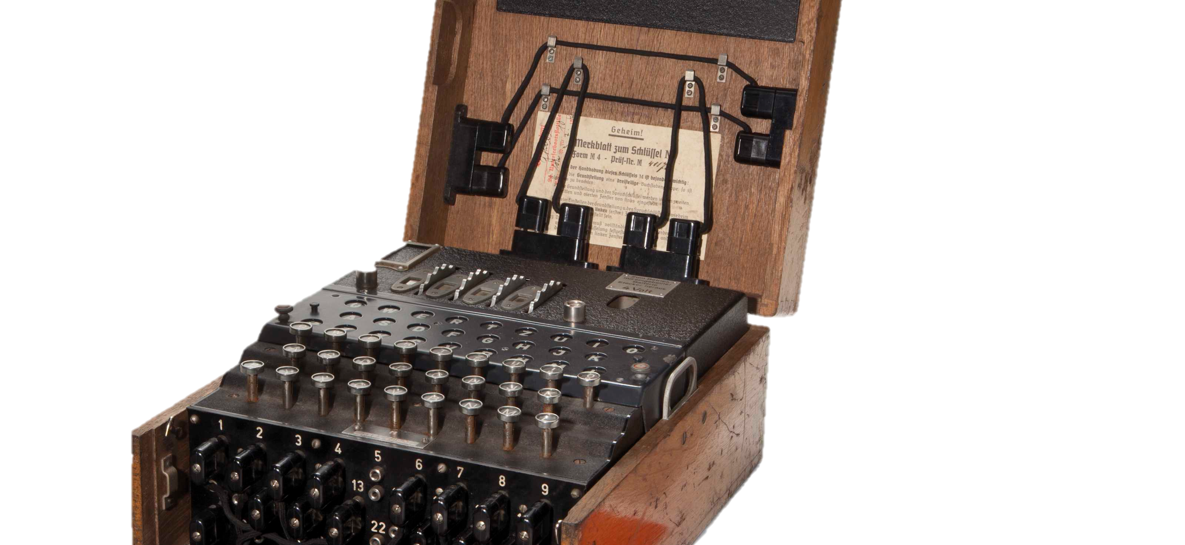
What is it Enigma Machine ?
The most famous encrypting machine in history.
Was in use by the Nazis and Italians in World War 2.
It had some different versions.

Slide 3
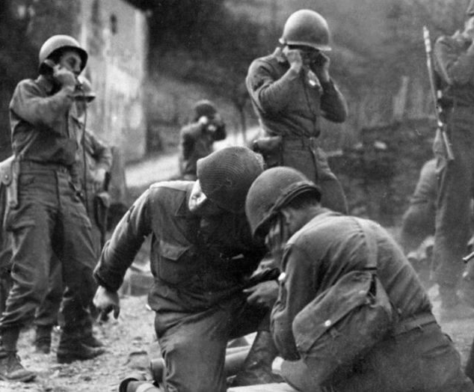
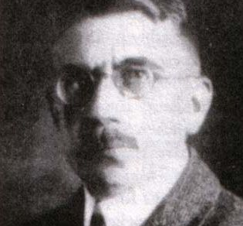
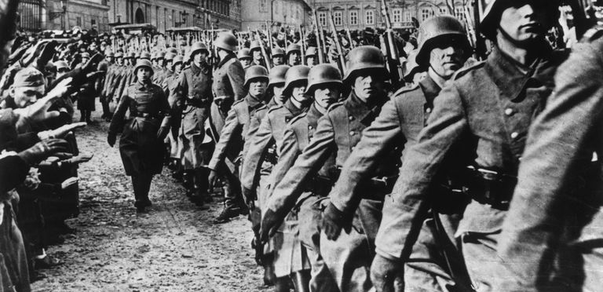
History
Invented in 1918 by Arthur Scherbius.
Adopted by military and government in the 1920s.
Before WW2, the Enigma was the main means of encryption of the submarine fleet, the army, the Nazi party, the Gestapo, the Foreign Ministry and intelligence of Nazi Germany.
Thanks to the Enigma, the Germans succeeded in besieging Britain.
The Enigma hacking was the main cause to the Soviet win in the Battle of Kursk.

Slide 4
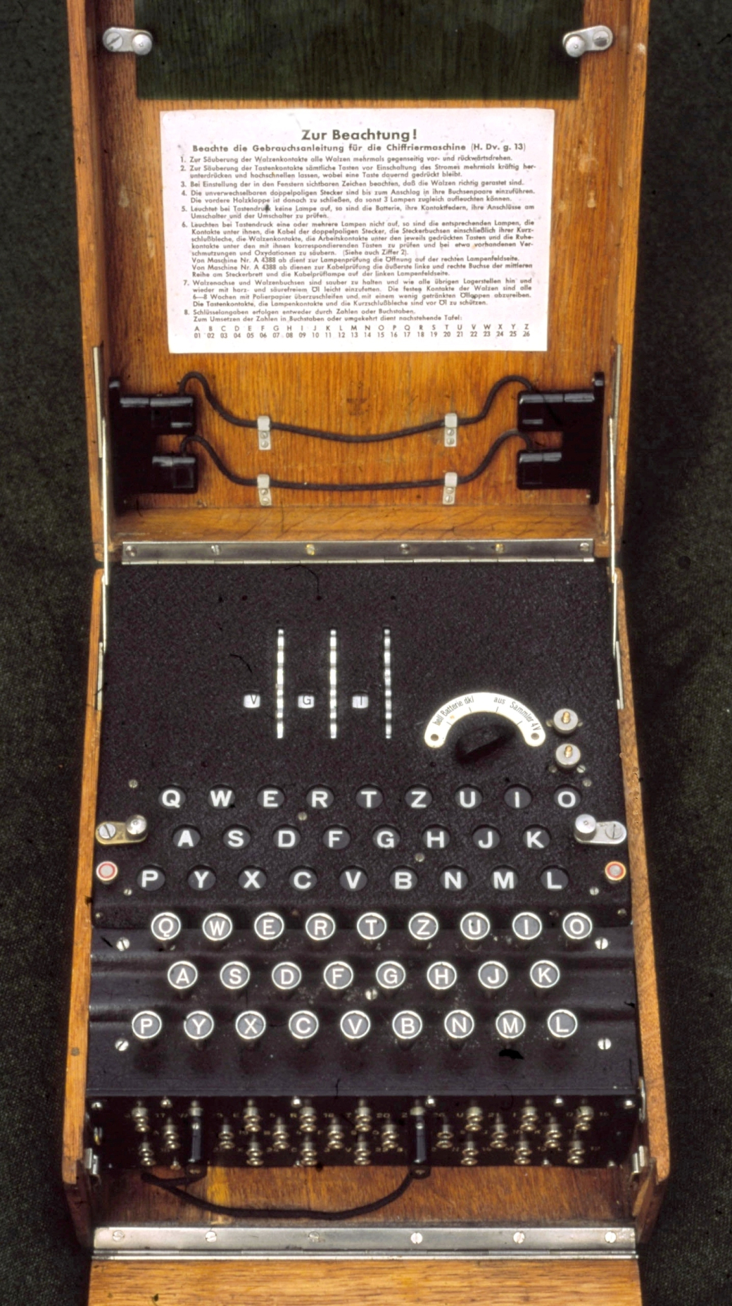
The structure of the Enigma machine
Rotors
LampBoard
KeyBoard
PlugBoard

Slide 5
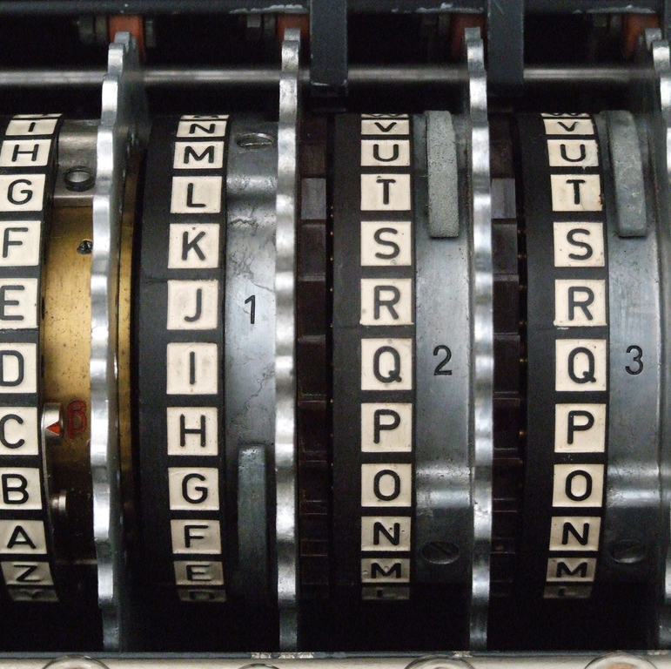
The rotors
The Enigma based on transformation cipher in every letter – great advantage.
The rotors - the heart of the Enigma.
The substitution of the letters is made by the rotors.
Each rotor – a substitution table.
The power of encryption - the number of rotors in series.
There are 3 rotors in the Enigma machine.

Slide 6
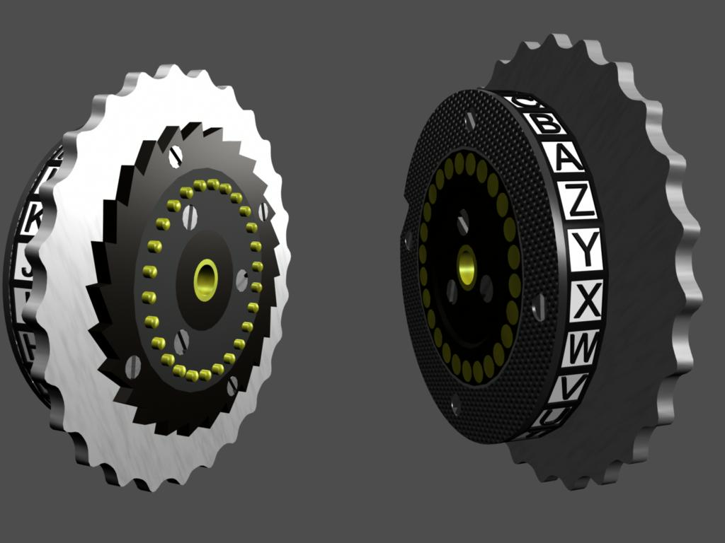
The rotors Structure
Each rotor has 2 sides:
One side that includes 26 pins.
Second side that includes 26 Electrical pads.
Each pin connected to an electric pad – electric circuit.
This connection creates a transformation of a letter.

Slide 7
The Enigma Stepping
Motivation: To avoid a simple transformation encryption.
A mechanism that responsible for rotate of 3 motors on each click of a letter.
When a button is pressed, the rotors move before the electric circuit closes.
Alice and Bob must know the initial positions of the spinning motors.

Slide 8
The Stepping mechanism
Rotor 1 spins when a letter was clicked.
Rotor 2 spins every 26x26=676 letters – one round of rotor 2.
Rotor 3 spins every 26x26x26=17,576 letters – one round of rotor 3.
Result: The encryption transformation is different on every click of a letter.

Slide 9
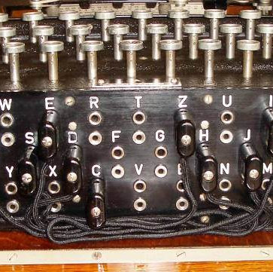
The PlugsBoard
Every single letter has a plug.
The Germans connected 10 cables between every two letters, in order to get a stronger encryption. This part used after the encryption or decryption parts.

Slide 10
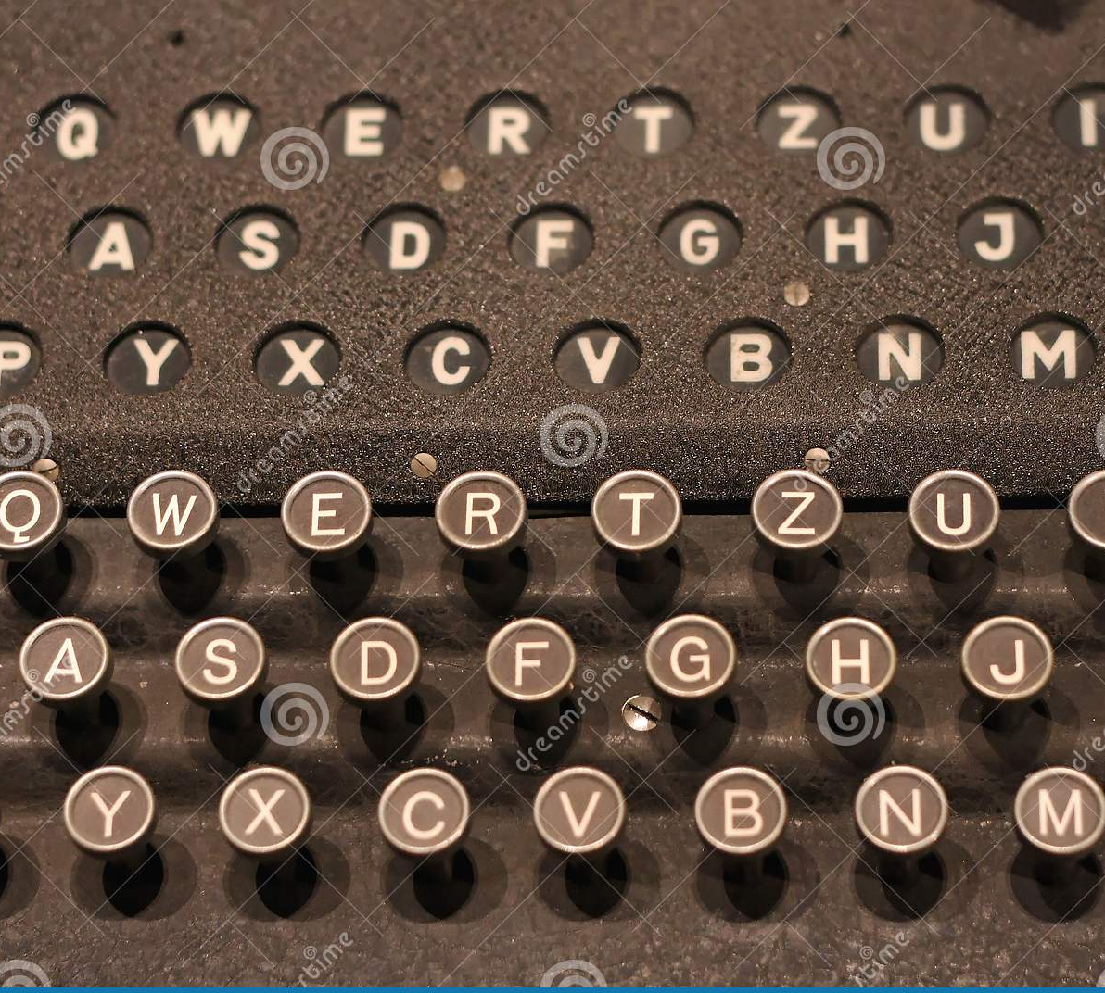
LampBoard & KeyBoard
The LampBoard – The encrypted letters will show up here.
The keyBoard – Type the message you want to encrypt by clicking on the keys.

Slide 11
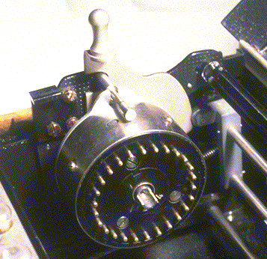
The Reflector
The Reflector was a component at the end of the array of rotors that would reflect the electrical current back through the rotors in the opposite direction and through a different route.

Slide 12
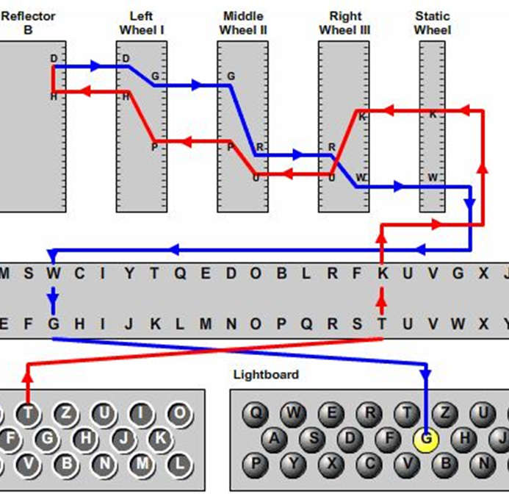
How The Encryption Work ?
The user types on a key.
An electric signal passes to the plug board instead of the actual key’s light.
The electric stream goes trough the plug of the plugs board.
The stream passes trough the three rotors.
It arrives to a reflector that redirects the stream reverse back to the rotors.
Then, back to the plugs board with the result.
The letter swapped with the other letter which connected by a cable.
From the plugs board the stream passes to the right light.

Slide 13



How The Encryption Work ?
Alice
Key1
E key1(msgA)= msgB
Bob
Key2
D key2(msgB)= msgA
Oscar
D ???(msgB)= ???

Slide 14
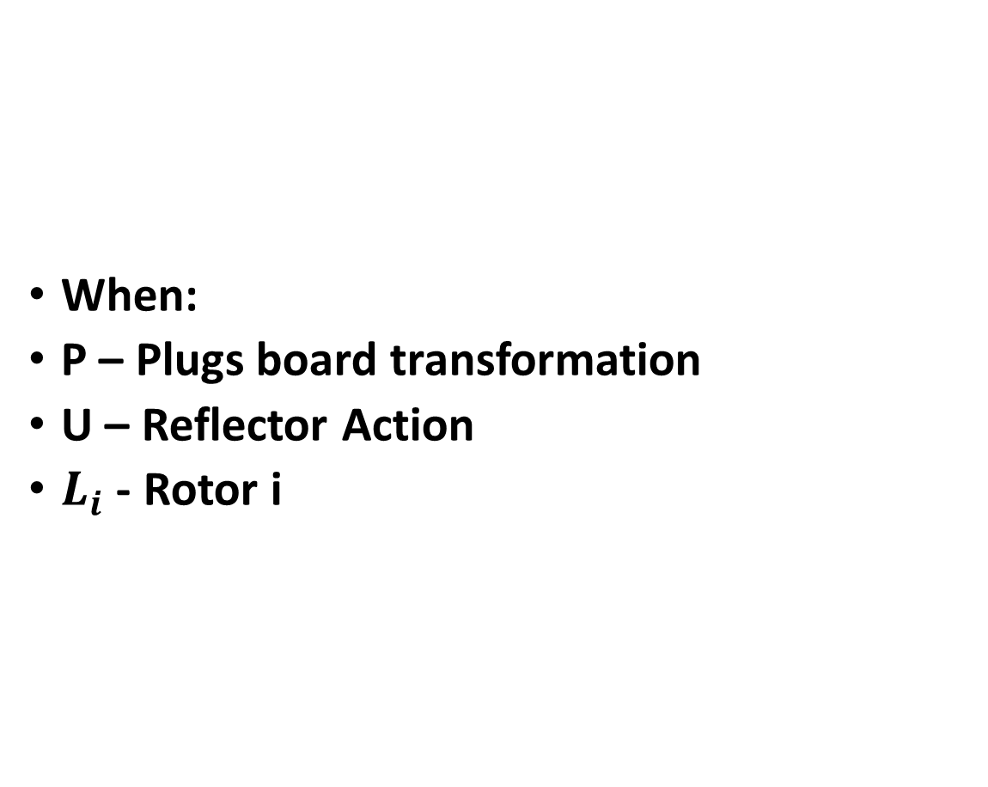
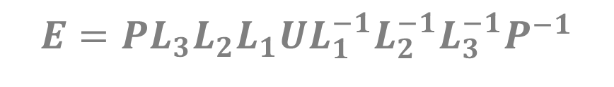
Encryption Function
When:
P – Plugs board transformation
U – Reflector Action
$L_{i}$ - Rotor i
$$E=PL_{3}L_{2}L_{1}UL_{1}^{−1}L_{2}^{−1}L_{3}^{−1}P^{−1}$$

Slide 15
How the Decryption Work ?
The user types the cipher key.
Because the flow is reversible thanks to the reflector, we will get the original key.
It requires the two sides to have the same configuration.

Slide 16
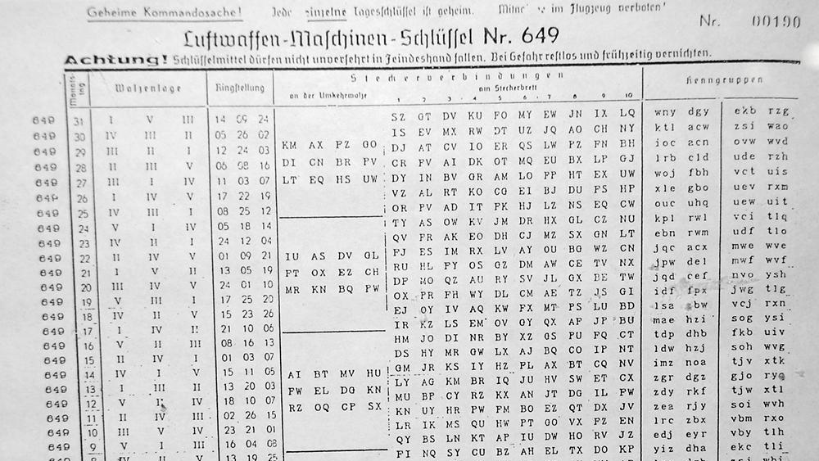
The Keys Sharing
High-rank officers wrote a monthly “Initialization paper" that was delivered to the sender and recipient.
This paper included:
How to connect the cables in the plugs panel.
The rotors and their order.
Initial position of each rotor.
These papers were very classified.

Slide 17
Enigma Scaled Version
A → C
B → F
C ↔A
A
A
B
B
C
C
D
D
E
E
F
F
Keyboard
Rotor 3
Rotor 2
Rotor 1
Reflector
Lightboard

Slide 18
A ↔F
B ↔ E
C ↔ D
A
A
B
B
C
C
D
D
E
E
F
F
Keyboard
Rotor 3
Rotor 2
Rotor 1
Reflector
Lightboard
Plugboard

Slide 19
Plaintext : A
Ciphertext : F
A
A
B
B
C
C
D
D
E
E
F
F
Keyboard
Rotor 3
Rotor 2
Rotor 1
Reflector
Lightboard
Plugboard

Slide 20
Plaintext : A
Ciphertext : F
A
A
B
B
C
C
D
D
E
E
F
F
Keyboard
Rotor 3
Rotor 2
Rotor 1
Reflector
Lightboard
Plugboard

Slide 21
Plaintext : AA
Ciphertext : FC
A
A
B
B
C
C
D
D
E
E
F
F
Keyboard
Rotor 3
Rotor 2
Rotor 1
Reflector
Lightboard
Plugboard

Slide 22
Plaintext : AAE
Ciphertext : FCB
A
A
B
B
C
C
D
D
E
E
F
F
Keyboard
Rotor 3
Rotor 2
Rotor 1
Reflector
Lightboard
Plugboard

Slide 23
Plaintext : AAEF
Ciphertext : FCBE
A
A
B
B
C
C
D
D
E
E
F
F
Keyboard
Rotor 3
Rotor 2
Rotor 1
Reflector
Lightboard
Plugboard

Slide 24
Plaintext : AAEFA
Ciphertext : FCBEF
A
A
B
B
C
C
D
D
E
E
F
F
Keyboard
Rotor 3
Rotor 2
Rotor 1
Reflector
Lightboard
Plugboard

Slide 25
Plaintext : AAEFAD
Ciphertext : FCBEFC
A
A
B
B
C
C
D
D
E
E
F
F
Keyboard
Rotor 3
Rotor 2
Rotor 1
Reflector
Lightboard
Plugboard

Slide 26
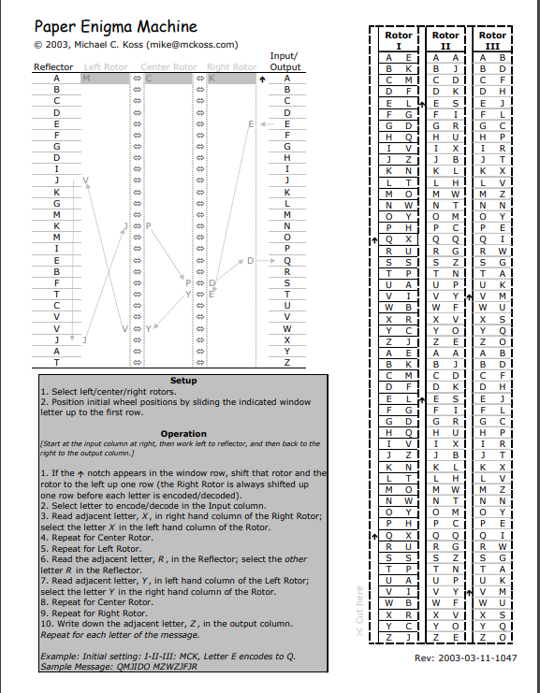
Paper Enigma Machine

Slide 27
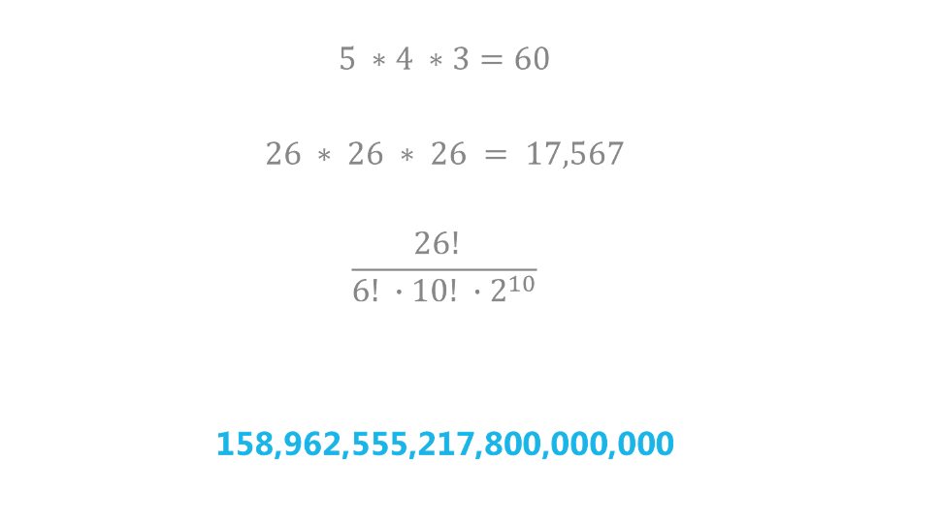
Keys
Choosing the rotors :
Position of the rotors :
Plugboard Boot:
Total options to initialize the machine: 158,962,555,217,800,000,000 ≈ 2⁶⁷

Slide 28
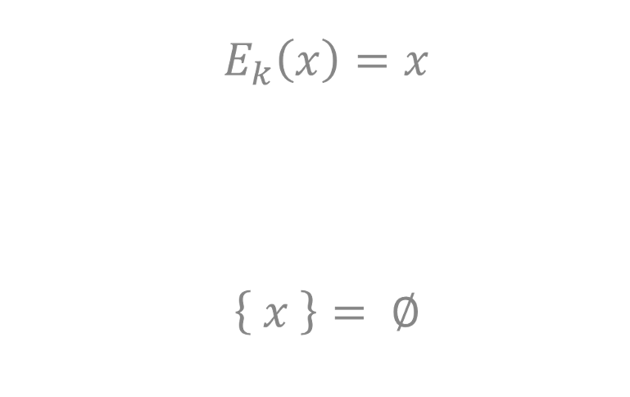
Unhidden Messages
As we learned:
The Enigma machine design ensures that no character will be encrypted to itself:

Slide 29
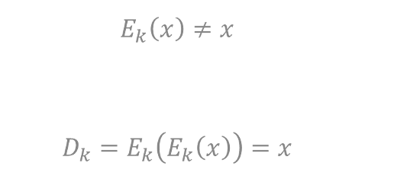
Security Weaknesses
A character can never be encrypted to itself:
Decryption is performed as the encryption:
Before moving to the next rotor the rightest rotor must rotate a certain number of times.

Slide 30

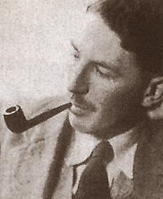
Cracking The Enigma
Alan Turing
Gordon Welchman

Slide 31
Cracking The Enigma
The cracking team tried to find word patterns that appear high frequency of times.
There were known phrases such as "Hale Hitler" or "Please respond" which may appear frequently in some texts.
One of the important approaches to crack code was based on the fact that the reflector ensured that no signal would be encrypted for itself.
Plain text could be reached by experimenting with all options against the encrypted text.

Slide 32
Cracking The Enigma (Cont.)
Assume we know the rotor position otherwise brute- force.
We guess a word which we think appears in the message.
best a longer word which appears at the very beginning or end.
Check which positions are possible using the flaw.
Make a plugboard guess.
Deduce more plugboard setting.
If all 26 plugboard guessing fail then choose next rotors setting.
Otherwise if no contradiction check if the message make sense.

Slide 33
Example secret / guess
Z V U G J C W R X V H Q F Q D G I B Y K P A W R K X D V L
W E A T H E R R E P O R T
WRONG
Z V U G J C W R X V H Q F Q D G I B Y K P A W R K X D V L
W E A T H E R R E P O R T
WRONG
Z V U G J C W R X V H Q F Q D G I B Y K P A W R K X D V L
W E A T H E R R E P O R T
Correct
Assume Plugboard connection (RA)
Plugboard
A
Rotors
H
Plugboard
R
E
Pick a position and find what happens to ‘A’
Deduce (HE)

Slide 34
Plugboard
A
Rotors
K
Plugboard
If we have connected RA then we have to connect RE ad KX.
R
X
Deduce (KX)
Plugboard
A
Rotors
L
Plugboard
R
V
Deduce (LV)
Plugboard
E
Rotors
O
Plugboard
H
E
Deduce (OE)
WRONG (Contradiction)
If O is connected to E then it cannot be connected to H! then we defiantly know that R is not connected to A.
we need to check all plugs option from R to any letter, if it didn’t work then try other Rotor setting.
This process will take a lot of time but Alan have noticed that once we find one mistake this means all the deductions are wrong which made the process much more faster.

Slide 35
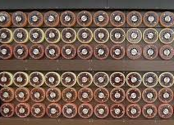
BOMBE
The BOMBE tried every possible rotor position and for each test performed a particular test.
The test eliminated thousands of possible positions of the three rotors.
The few possible solutions remaining were manually tested.
In order to use the BOMBE, the decoder had to produce a region of encrypted text for which the original text could be guessed.

Slide 36
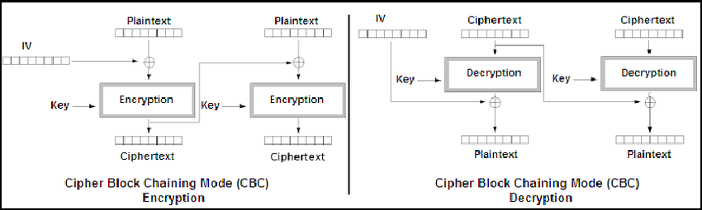
CBC mode

Slide 37
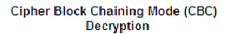
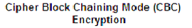
Inverse CBC mode
Encryption
Encryption
Decryption
Decryption

Slide 38
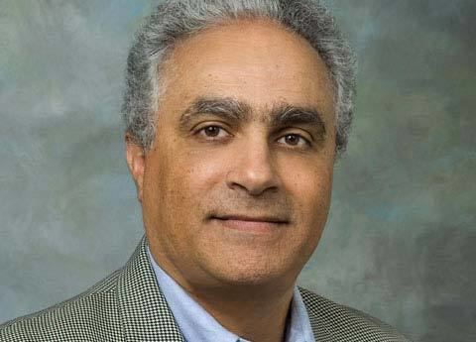
El-Gamal
Digital signature scheme.
Invented by Egyptian cryptographer Taher El-Gamal in 1985.
Uses hash function.
Digital signature’s purpose is to achieve 3 important cryptosystem principles:
Authentication.
Non-repudiation.
Integrity.

Slide 39

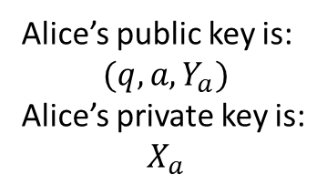
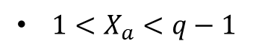
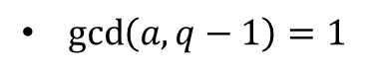
How it’s done Alice’s initialization
Pick a big prime ‘q’
Pick a generator ‘a’
Pick a secret number ‘$X_{a}$’
Pick a secret number ‘𝑋_𝑎’
Compute public number $′Y_{a}′$
Compute public number ′𝑌_𝑎′
$\gcd\left(a,q−1\right)=1$
$1<X_{a}<q−1$
$Y_{a}=a^{X_{a}} mod q$
Alice’s public key is:
$$(q,a,Y_{a})$$
Alice’s private key is:
$$X_{a}$$

Slide 40
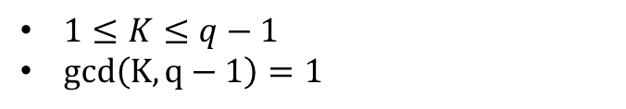
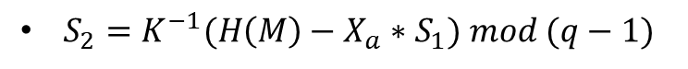
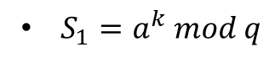
How it’s done Signing a message
$1≤K≤q−1$
$gcd\left(K,q−1\right)=1$
Pick random integer number K
Calculate $S_{1}$
Calculate 𝑆_1
Calculate $S_{2}$
Calculate 𝑆_2
Send $\left(S_{1},S_{2}\right).$
Send (𝑆_1,𝑆_2 ).
K is used only once
$S_{1}=a^{k} mod q$
$S_{2}=K^{−1}(H\left(M\right)−X_{a}∗S_{1}) mod (q−1)$

Slide 41
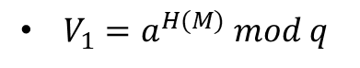
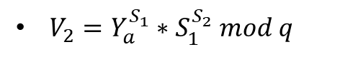
How it’s done Bob’s verification
Calculate $V_{1}$
Calculate 𝑉_1
Calculate $V_{2}$
Calculate 𝑉_2
Assert $V_{1}=V_{2}$
Assert 𝑉_1=𝑉_2
$V_{1}=a^{H(M)} mod q$
$V_{2}=Y_{a}^{S_{1}}∗S_{1}^{S_{2}} mod q$

Slide 42
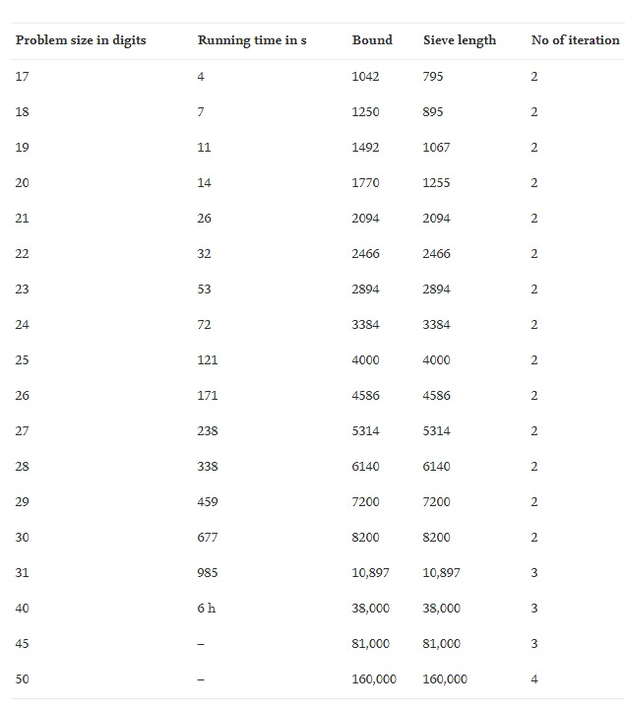

Attacks and flaws of El-Gamal
$S_{1}=k^{−1}(\left(H\left(M_{1}\right)−a∗r\right)mod (q−1)$
$S_{2}=K^{−1}(\left(H\left(M_{2}\right)−a∗r\right)mod (q−1)$
$\left(S_{1}−S_{2}\right)∗K=H\left(M_{1}\right)−H\left(M_{2}\right)mod (q−1)$
$if\left(S_{1}−S_{2}≠0 mod \left(q−1\right)\right)$
$K={\left(S_{1}−S_{2}\right)}^{−1}\left(H\left(M_{1}\right)−H\left(M_{2}\right)\right) mod (q−1)$

Slide 43
Enigma improvements
CBC Mode
El Gamal digital signature
How did CBC improved the Enigma obstacles?
CBC never encrypts the same plaintext block in the same way, preventing the code-book attack. A major flaw with the Enigma code was that a letter could never be encoded as itself. In other words, an “M” would never be encoded as an “M.” This was a huge flaw in the Enigma code because it gave codebreakers a piece of information they could use to decrypt messages, but with CBC mode it encrypts the same plaintext in different ways which may result to encrypt the same letters to itself.

Slide 44
Example
Assume we have the following text encrypted with the enigma:
Plaintext = HELLOO = 0x48 0x45 0x4C 0x4C 0x4F 0x4F
Ciphertext = PQQIQN = 0x50 0x51 0x51 0x49 0x51 0x4E
We already know that each letters is encrypted to a different letter which is not itself.
Lets encrypt the same plaintext with Enigma with CBC mode, our block size is 3.
We can see that Enigma with CBC mode have encrypted the plaintext HELLO to
0x38 0x4D 0x4E 0x01 0x14 0x02
So the letter H has been encoded as itself, which overcomes that Enigma weakness .
P1: HEL
P2: LLO
Encryption
Encryption
PQQ
IQN
IV
+
+
C1: HMN = 0x48 0x4D 0x4E
C1: 0xC2 0x01 0x13 0x 02

Slide 45

Application design

Slide 46


Slide 47


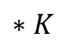
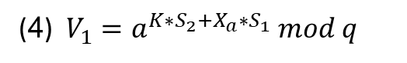
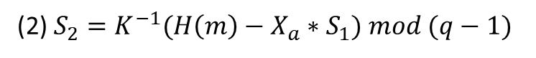
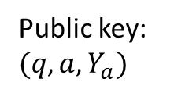
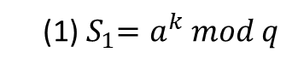
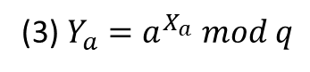
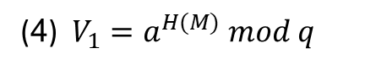
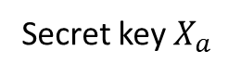
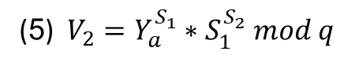
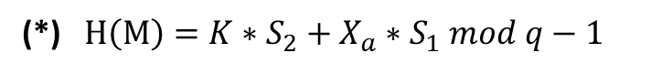
Why does it work?
Let’s see what we have so far:
Alice
Public key:
$$(q,a,Y_{a})$$
Bob
Secret key $X_{a}$
(4) $V_{1}=a^{H(M)} mod q$
(1)${ S}_{1}=a^{k} mod q$
(5) $V_{2}=Y_{a}^{S_{1}}∗S_{1}^{S_{2}} mod q$
(2) $S_{2}=K^{−1}(H\left(m\right)−X_{a}∗S_{1}) mod (q−1)$
(3) $Y_{a}=a^{X_{a}} mod q$
$$∗K$$
(4) $V_{1}=a^{K∗S_{2}+X_{a}∗S_{1}} mod q$
$${K∗S}_{2}= H\left(m\right)−X_{a}∗S_{1} mod q−1$$
(*) $H\left(M\right)={K∗S}_{2}+X_{a}∗S_{1} mod q−1$

Slide 48
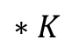
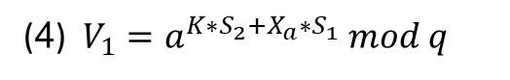
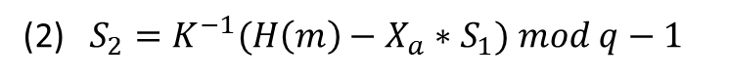
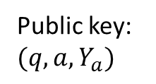
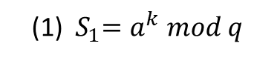




Public key:
$$(q,a,Y_{a})$$
Let’s see what we have so far:
Why does it work?
(2) $S_{2}=K^{−1}(H\left(m\right)−X_{a}∗S_{1}) mod q−1$
$$∗K$$
Bob
Alice
$${K∗S}_{2}= H\left(m\right)−X_{a}∗S_{1} mod q−1$$
(*) $H\left(M\right)={K∗S}_{2}+X_{a}∗S_{1} mod q−1$
Secret key $X_{a}$
(4) $V_{1}=a^{H(M)} mod q$
(1) ${ S}_{1}=a^{k} mod q$
(5) $V_{2}=Y_{a}^{S_{1}}∗S_{1}^{S_{2}} mod q$
(3) $Y_{a}=a^{X_{a}} mod q$
(4) $V_{1}=a^{K∗S_{2}+X_{a}∗S_{1}} mod q$

Slide 49






(2) $S_{2}=K^{−1}(H\left(m\right)−X_{a}∗S_{1}) mod q−1$
$$∗K$$
$${K∗S}_{2}= H\left(m\right)−X_{a}∗S_{1} mod q−1$$
Public key:
$$(q,a,Y_{a})$$
Let’s see what we have so far:
Why does it work?
(4) $V_{1}=a^{H(M)} mod q$
Bob
Alice
(*) $H\left(M\right)={K∗S}_{2}+X_{a}∗S_{1} mod q−1$
(4) $V_{1}=a^{K∗S_{2}+X_{a}∗S_{1}} mod q$
Secret key $X_{a}$
(1) ${ S}_{1}=a^{k} mod q$
(5) $V_{2}=Y_{a}^{S_{1}}∗S_{1}^{S_{2}} mod q$
(3) $Y_{a}=a^{X_{a}} mod q$
(5) $V_{2}={\left(a^{X_{a}}\right)}^{S_{1}}∗S_{1}^{S_{2}} mod q$

Slide 50







(4) $V_{1}=a^{H(M)} mod q$
(2) $S_{2}=K^{−1}(H\left(m\right)−X_{a}∗S_{1}) mod q−1$
$$∗K$$
$${K∗S}_{2}= H\left(m\right)−X_{a}∗S_{1} mod q−1$$
Public key:
$$(q,a,Y_{a})$$
(*) $H\left(M\right)={K∗S}_{2}+X_{a}∗S_{1} mod q−1$
Let’s see what we have so far:
Why does it work?
(5) $V_{2}=Y_{a}^{S_{1}}∗S_{1}^{S_{2}} mod q$
Bob
Alice
(3) $Y_{a}=a^{X_{a}} mod q$
(5) $V_{2}={\left(a^{X_{a}}\right)}^{S_{1}}∗S_{1}^{S_{2}} mod q$
Secret key $X_{a}$
(1) ${ S}_{1}=a^{k} mod q$
(4) $V_{1}=a^{K∗S_{2}+X_{a}∗S_{1}} mod q$
(5) $V_{2}={\left(a^{X_{a}}\right)}^{S_{1}}∗{\left(a^{k}\right)}^{S_{2}} mod q$

Slide 51





(5) $V_{2}=Y_{a}^{S_{1}}∗S_{1}^{S_{2}} mod q$
(4) $V_{1}=a^{H(M)} mod q$
(2) $S_{2}=K^{−1}(H\left(m\right)−X_{a}∗S_{1}) mod q−1$
$$∗K$$
(3) $Y_{a}=a^{X_{a}} mod q$
Public key:
$$(q,a,Y_{a})$$
$${K∗S}_{2}= H\left(m\right)−X_{a}∗S_{1} mod q−1$$
Let’s see what we have so far:
(*) $H\left(M\right)={K∗S}_{2}+X_{a}∗S_{1} mod q−1$
Why does it work?
(5) $V_{2}={\left(a^{X_{a}}\right)}^{S_{1}}∗S_{1}^{S_{2}} mod q$
Bob
Alice
(1) ${ S}_{1}=a^{k} mod q$
(5) $V_{2}={\left(a^{X_{a}}\right)}^{S_{1}}∗{\left(a^{k}\right)}^{S_{2}} mod q$
Secret key $X_{a}$
(4) $V_{1}=a^{K∗S_{2}+X_{a}∗S_{1}} mod q$

Slide 52





(5) $V_{2}=Y_{a}^{S_{1}}∗S_{1}^{S_{2}} mod q$
(4) $V_{1}=a^{H(M)} mod q$
(2) $S_{2}=K^{−1}(H\left(m\right)−X_{a}∗S_{1}) mod q−1$
$$∗K$$
(3) $Y_{a}=a^{X_{a}} mod q$
Public key:
$$(q,a,Y_{a})$$
$${K∗S}_{2}= H\left(m\right)−X_{a}∗S_{1} mod q−1$$
Let’s see what we have so far:
(*) $H\left(M\right)={K∗S}_{2}+X_{a}∗S_{1} mod q−1$
(5) $V_{2}={\left(a^{X_{a}}\right)}^{S_{1}}∗S_{1}^{S_{2}} mod q$
(1) ${ S}_{1}=a^{k} mod q$
Why does it work?
Bob
Alice
(4) $V_{1}=a^{K∗S_{2}+X_{a}∗S_{1}} mod q$
$$==$$
(5) $V_{2}={\left(a^{X_{a}}\right)}^{S_{1}}∗({a^{K})}^{S_{1}}mod q$
Secret key $X_{a}$

Slide 53


Enigma’s unicity distance
In English, the parameter D equals 3.4 $\frac{bit}{letter}$
Enigma has $2^{67}$ possible keys, with equal probability to be used.
Hence, the unicity distance is: $\frac{\log_{2}\left(2^{67}\right)}{3.4}=20 letters$

